Slide 1


Ahmed Mohamed
3-May-2022

Slide 2

Outline
Executive Summary
Introduction
Methodology
Results
Conclusion

Slide 3
Executive Summary
Methodologies
Data Collection
Through API
with Web Scraping
Data Wrangling
Exploratory Data Analysis
With SQL
with Data Visualization
Interactive Visual Analytics
With Folium
With Plotly Dash
Machine Learning Prediction
Summary of all results and EDA
Exploratory Data Analysis result
Interactive analytics in screenshots
Predictive Analytics result

Slide 4
Introduction
Project background and context
Space X advertises Falcon 9 rocket launches on its website with a cost of 62 million dollars; other providers cost upward of 165 million dollars each, much of the savings is because Space X can reuse the first stage. Therefore, if we can determine if the first stage will land, we can determine the cost of a launch. This information can be used if an alternate company wants to bid against space X for a rocket launch. This goal of the project is to create a machine learning pipeline to predict if the first stage will land successfully.
Problems you want to find answers
Reasons of a successful landing?
Connection between features that makes a landing successful?
How to increase the success rate of the rocket?

Slide 5


Slide 6
Methodology
Executive Summary
Data collection methodology:
Describe how data was collected
Perform data wrangling
Describe how data was processed
Perform exploratory data analysis (EDA) using visualization and SQL
Perform interactive visual analytics using Folium and Plotly Dash
Perform predictive analysis using classification models
How to build, tune, evaluate classification models

Slide 7
Data Collection
Data was collected using two methods:
Using the official SpaceX API
Data was collected by requesting it from the API and receiving a JSON response
The JSON is then converted into a Pandas DataFrame using .json_normalize() method.
And by using BeautifulSoup for web scraping of a Wikipedia page
The HTML table that had the data needed was scraped and extracted
Then the HTML table was converted into a Pandas DataFrame and saved as a .csv

Slide 8
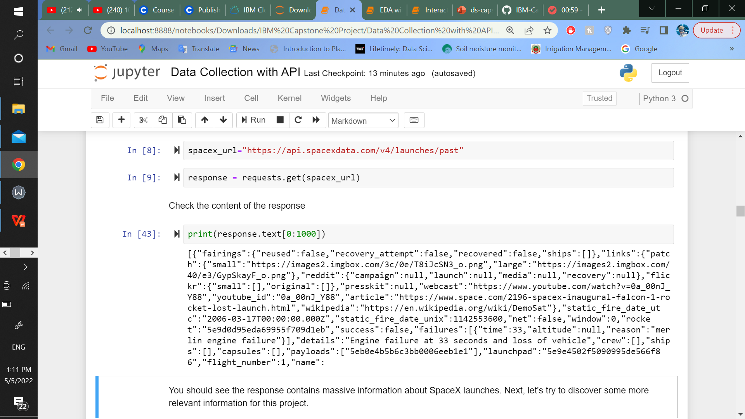
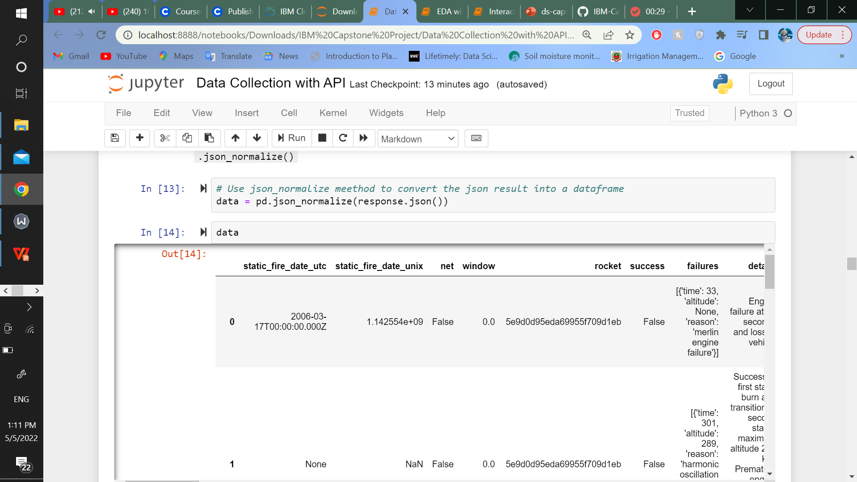
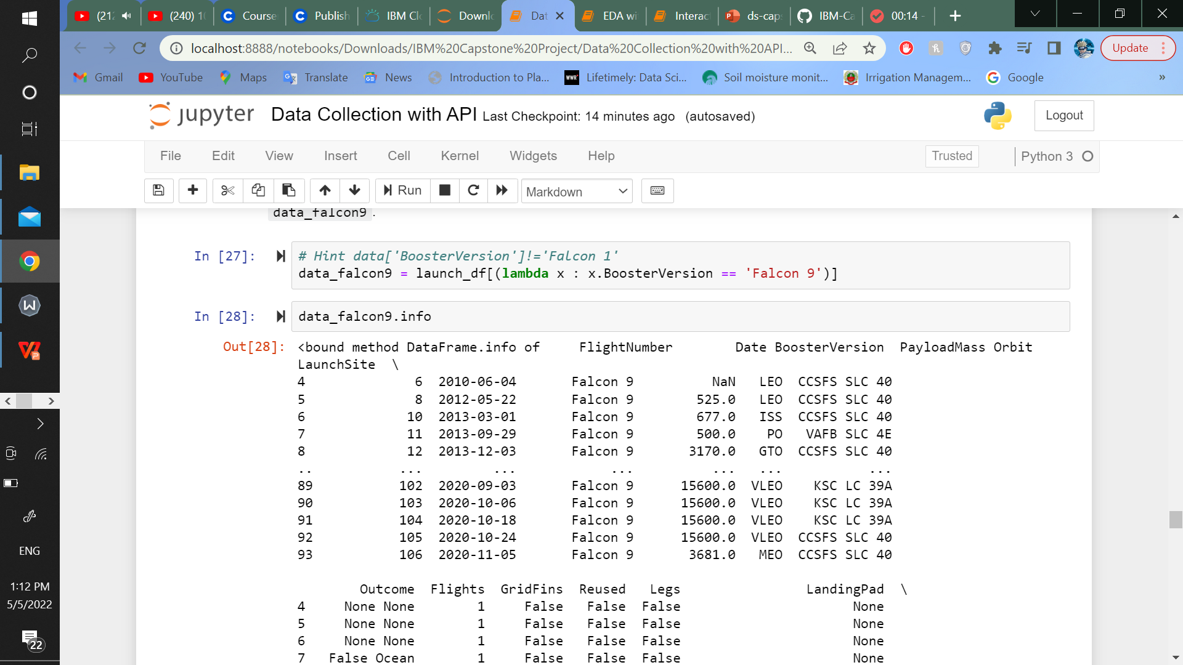
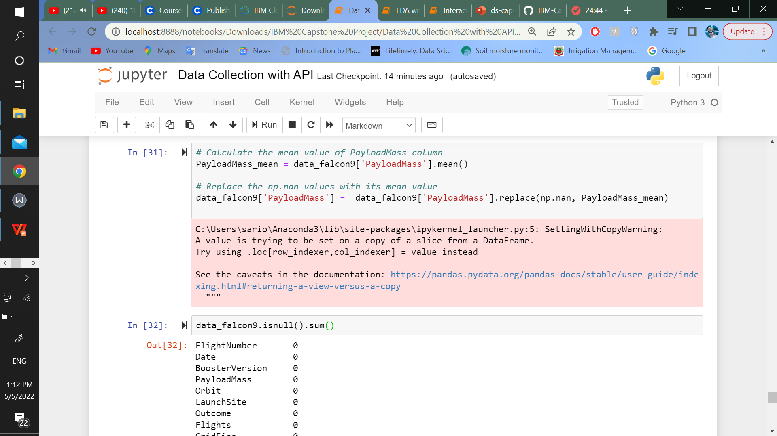
Data Collection – SpaceX API
The SpaceX RESTful API was used to collect, clean the data and perform some wrangling to it.
https://github.com/Ahmed-M-Osman/IBM-Capstone-Project/blob/master/Data%20Collection%20with%20API.ipynb

Slide 9
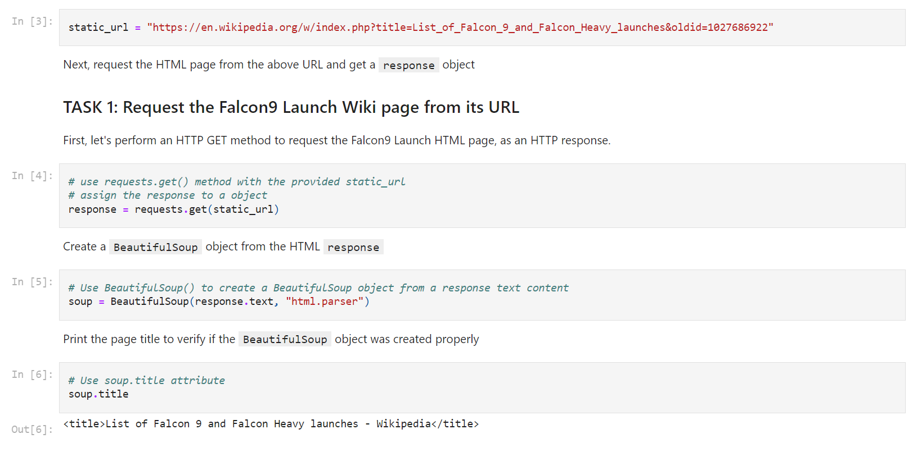
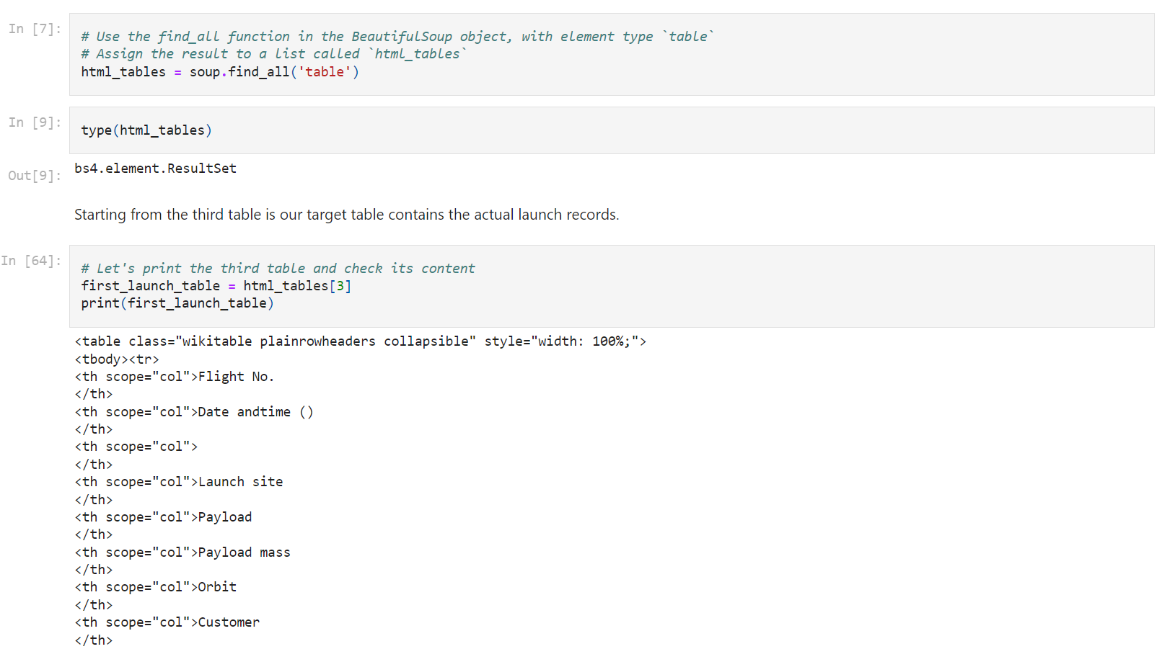
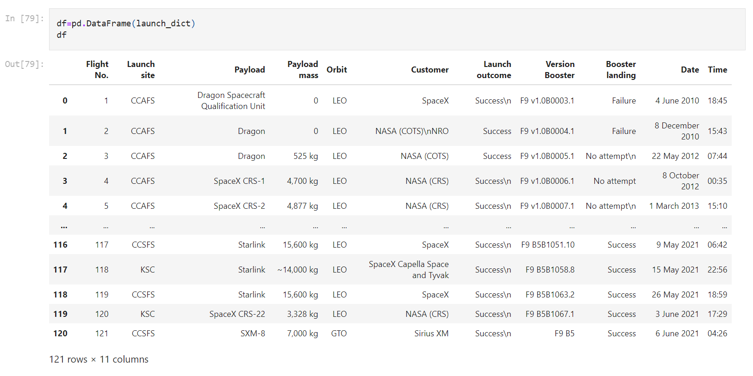
Data Collection - Scraping
Web scrapping to a Wikipedia page that had Falcon 9 launch records was done with BeautifulSoup.
The table was parsed and converted into a pandas dataframe and saved as a csv file.
https://github.com/Ahmed-M-Osman/IBM-Capstone-Project/blob/master/Data%20Collection%20with%20Web%20Scraping.ipynb

Slide 10
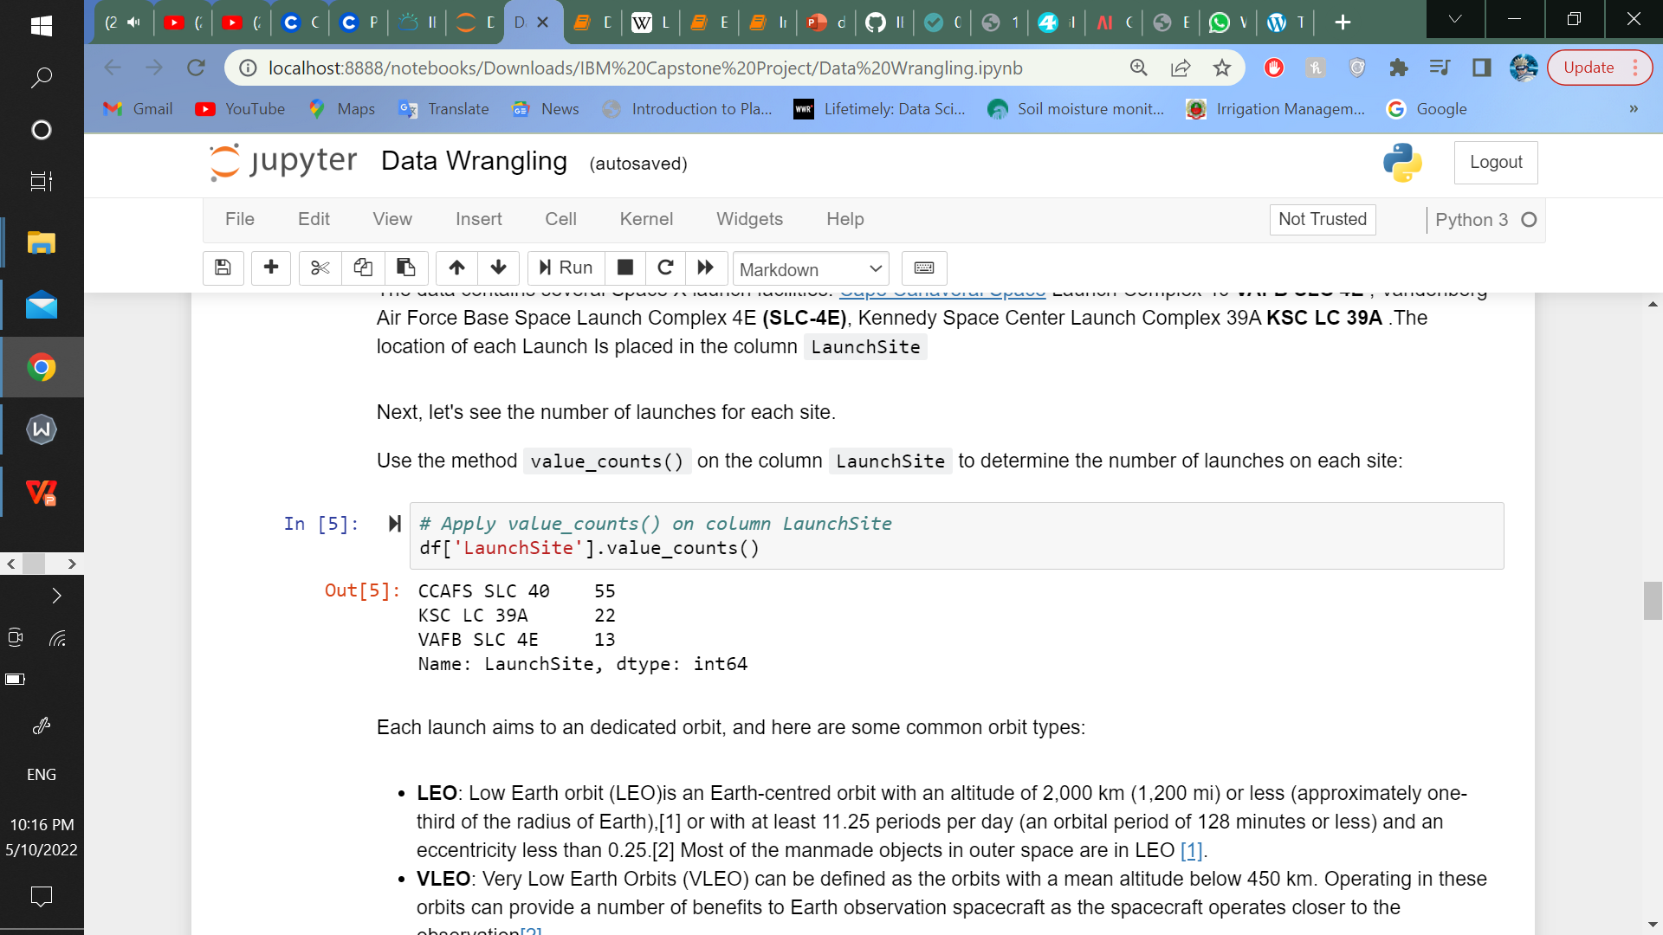
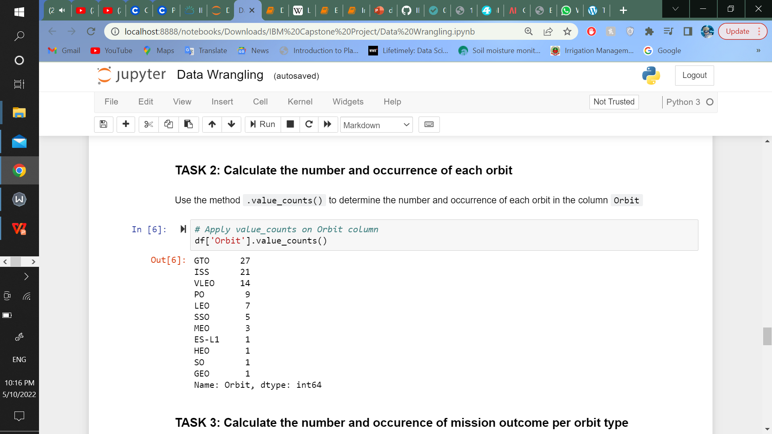
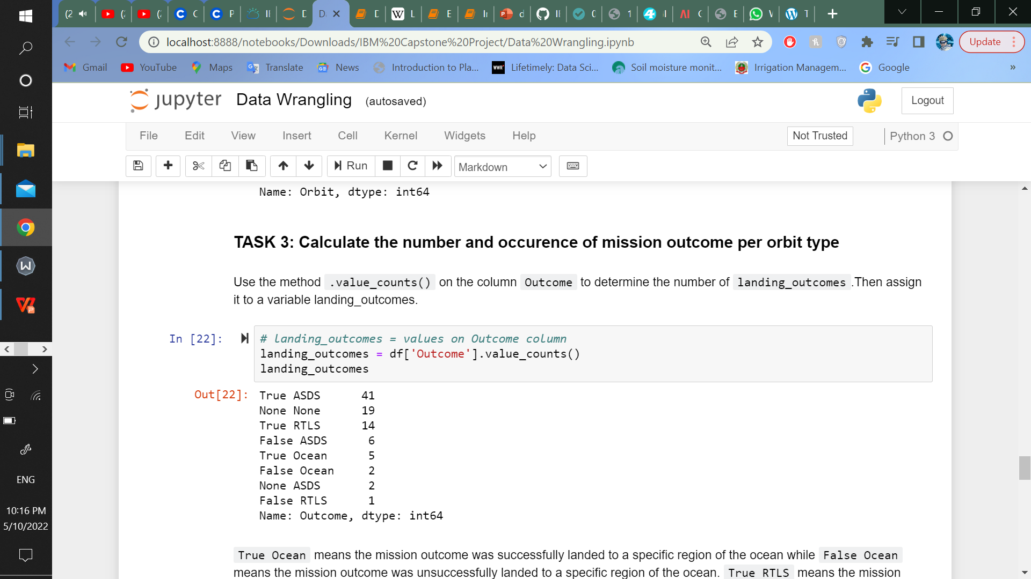
Data Wrangling
In this step, exploratory data analysis was done on the dataset, and we calculated:
number of launches on each site
number and occurrence of each orbit
number and occurrence of mission outcome per orbit type
We also created a landing outcome label from Outcome column
https://github.com/Ahmed-M-Osman/IBM-Capstone-Project/blob/master/Data%20Wrangling.ipynb

Slide 11
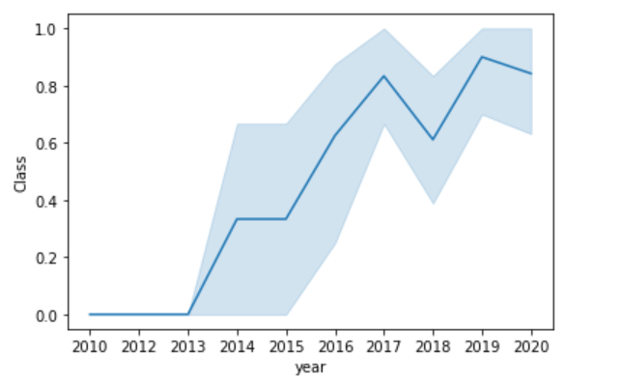
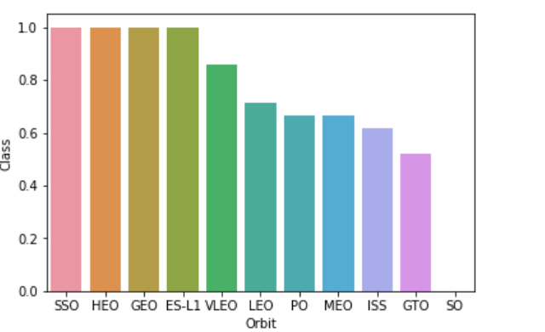
EDA with Data Visualization
EDA was performed on the data by visualizing the relationship between
- Flight number and launch site - Payload and launch site
- Success rate of each orbit type - Flight number and orbit type
- Payload and orbit type - Launch success yearly trends
https://github.com/Ahmed-M-Osman/IBM-Capstone-Project/blob/master/EDA%20with%20Data%20Visualization.ipynb

Slide 12
Build an Interactive Map with Folium
All launch sites were marked, and map objects like markers, circles, lines were added to mark the failure or success of launches for each site on Folium map.
Success/Fail launches for each site on the map was marked.
Launch outcomes feature 0 for failure, and 1 for success was added.
Distances between a launch site to its proximities were calculated. Below questions were answered for example:
Are launch sites in close proximity to railways?
Are launch sites in close proximity to highways?
Are launch sites in close proximity to coastline?
Do launch sites keep certain distance away from cities?
https://github.com/Ahmed-M-Osman/IBM-Capstone-Project/blob/master/Interactive%20Visual%20Analytics%20with%20Folium%20lab.ipynb

Slide 13
EDA with SQL
SpaceX dataset was loaded from a PostgreSQL database within the Jupyter notebook.
SQL queries were written to find out:
- Names of the unique launch sites in the space mission - 5 Records where launch sites begin with the string 'CCA'
- Total payload mass carried by boosters launched by NASA (CRS) - Average payload mass carried by booster version F9 v1.1
- Date when the first successful landing outcome in ground pad was achieved
- Names of the boosters which have success in drone ship and have payload mass greater than 4000 but less than 6000
- Total number of successful and failure mission outcomes
- Names of the booster_versions which have carried the maximum payload mass. Use a subquery
- Failed landing_outcomes in drone ship, their booster versions, and launch site names for in year 2015
- Count of landing outcomes (such as Failure (drone ship) or Success (ground pad)) between the date 2010-06-04 and 2017-03-20, in descending order
https://github.com/Ahmed-M-Osman/IBM-Capstone-Project/blob/master/EDA%20with%20SQL.ipynb

Slide 14
Build a Dashboard with Plotly Dash
An interactive dashboard with Plotly Dash was build
Also Pie Charts showing the total launches by a certain site were drawn
Scatter Graph showing the relationship with Outcome and Payload Mass (Kg) for the different booster version was drawn as well.
https://github.com/Ahmed-M-Osman/IBM-Capstone-Project/blob/master/Interactive%20Visual%20Analytics%20with%20Plotly%20Dash%20lab.ipynb

Slide 15
Predictive Analysis (Classification)
The data was loaded with Pandas and NumPy, then Standardized, and split into training and testing sets.
Four machine learning models were build ( logistic regression, support vector machine, decision tree classifier, k nearest neighbors )
The hyperparameters were tuned using GridSearchCV.
accuracy_score() was used as the metric for the models.
The best performing classification model was found.
https://github.com/Ahmed-M-Osman/IBM-Capstone-Project/blob/master/Machine%20Learning%20Prediction%20lab.ipynb

Slide 16
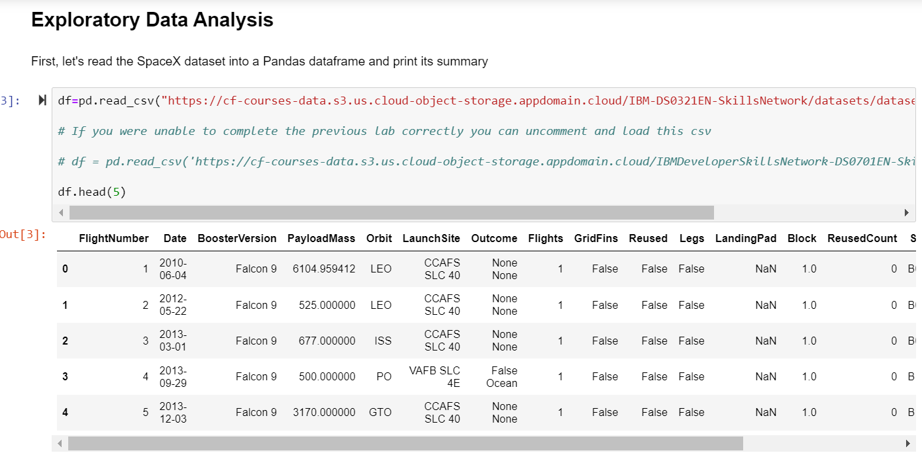
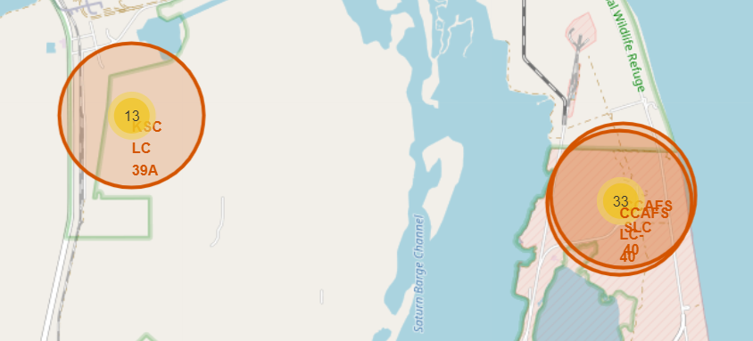
Results

Slide 17

Section 2

Slide 18
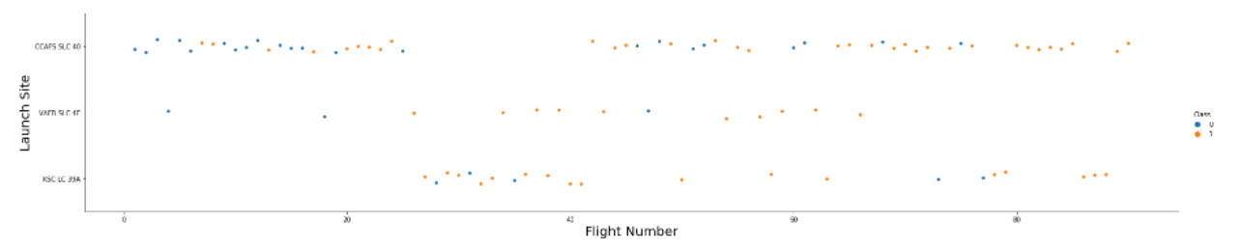
Flight Number vs. Launch Site
From the plot, it was found that the larger the flight amount at a launch site, the greater the success rate at a launch site.
Also, launch site CCAFS LC-40 had the most flights and the most success rate.

Slide 19
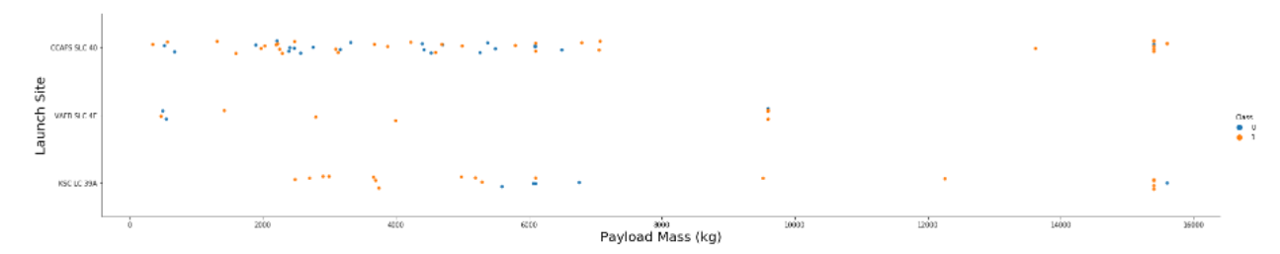
Payload vs. Launch Site
The greater the mass of the payload the higher the success rate
Launch site VAFB SLC-4E doesn't launch heavy payloads > 10000

Slide 20
Success Rate vs. Orbit Type
From the plot, it was shown that SSO, HEO, GEO ES-L1, VLEO had the most success rate.

Slide 21
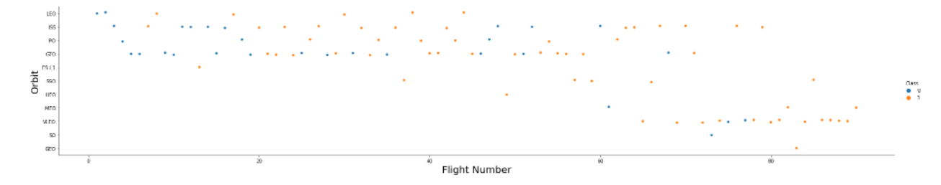
Flight Number vs. Orbit Type
The plot below shows the Flight Number vs. Orbit type. It was observed that in the LEO orbit, success is related to the number of flights whereas in the GTO orbit, there is no relationship between flight number and the orbit.

Slide 22
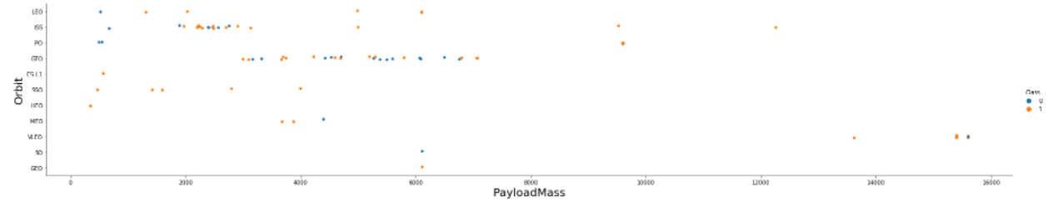
Payload vs. Orbit Type
It was observed that with heavy payloads, the successful landing are more for Polar, LEO and ISS orbits.
However for GTO we cannot distinguish this well as both positive landing rate and negative landing (unsuccessful mission) are both there here.

Slide 23
Launch Success Yearly Trend
It was observed that the sucess rate since 2013 kept increasing till 2020

Slide 24
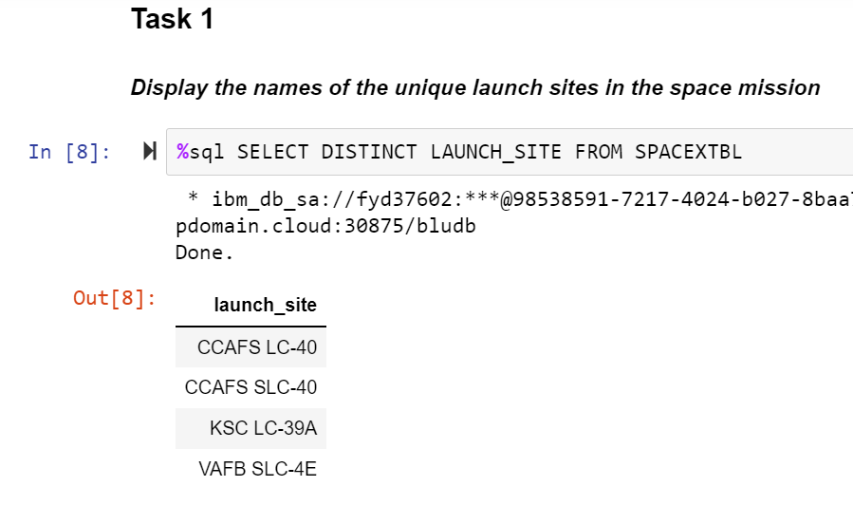
All Launch Site Names
The key word DISTINCT was used to show only unique launch sites from the SpaceX data.

Slide 25
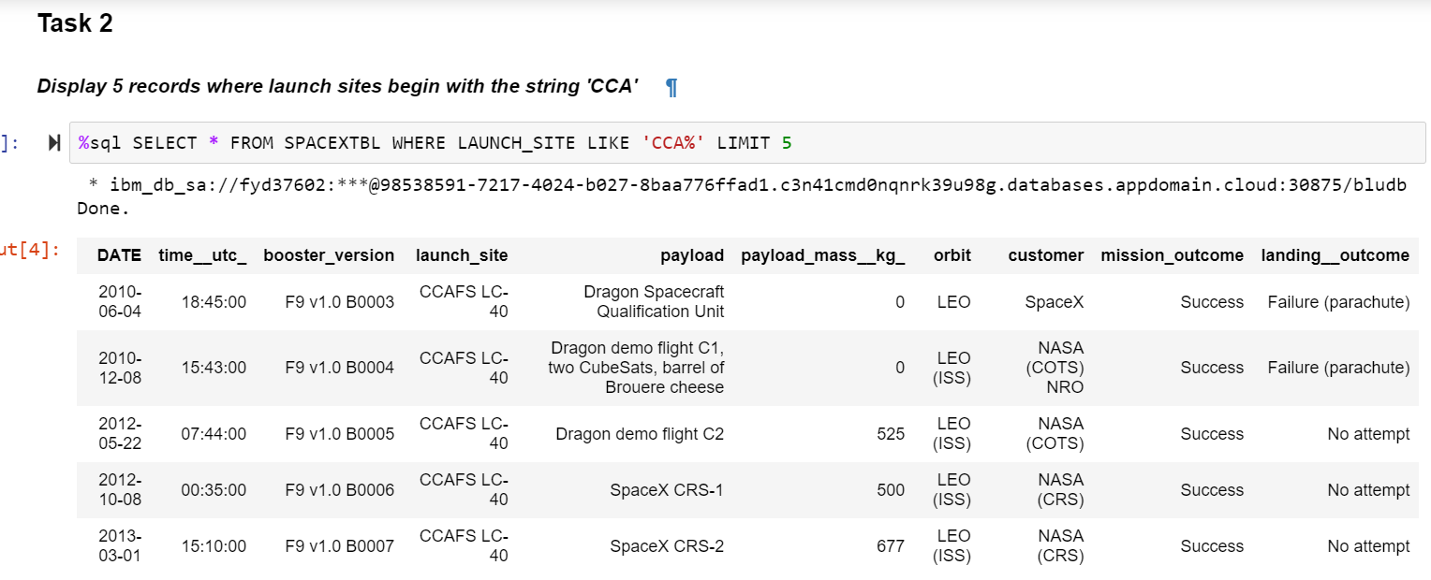
Launch Site Names Begin with 'CCA'
A query with the LIKE keyword was used to display records where launch sites begin with `CCA` and LIMIT was used to show only 5 records

Slide 26
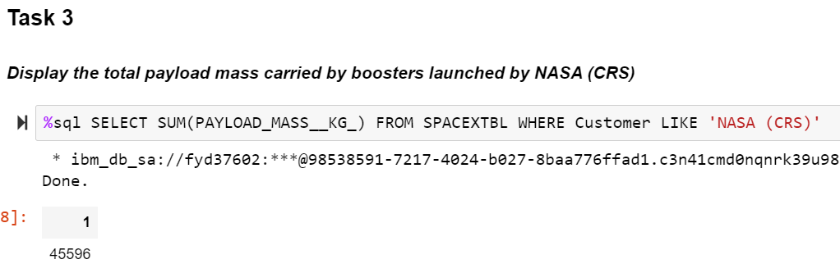
Total Payload Mass
The total payload carried by boosters from NASA (CRS) was calculated as 45596 using the query below

Slide 27
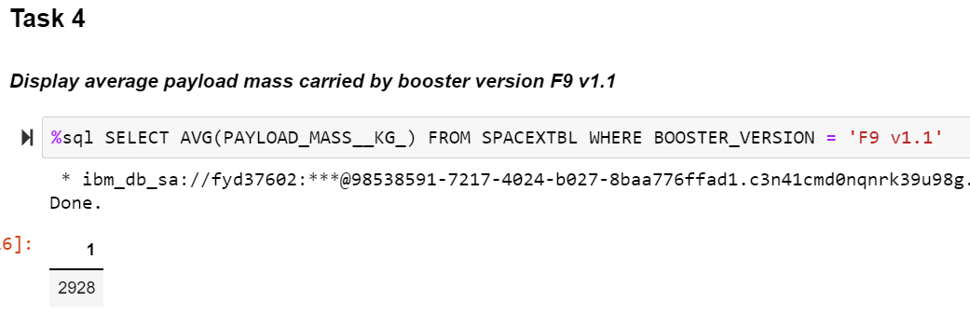
Average Payload Mass by F9 v1.1
The average payload mass carried by booster version F9 v1.1 was calculated as 2928.4 as shown below

Slide 28
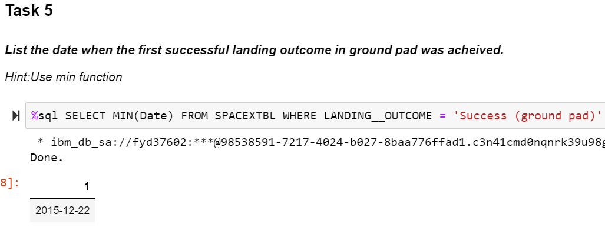
First Successful Ground Landing Date
It was observed that the date of the first successful landing outcome on ground pad was the 22nd December 2015 as shown below

Slide 29
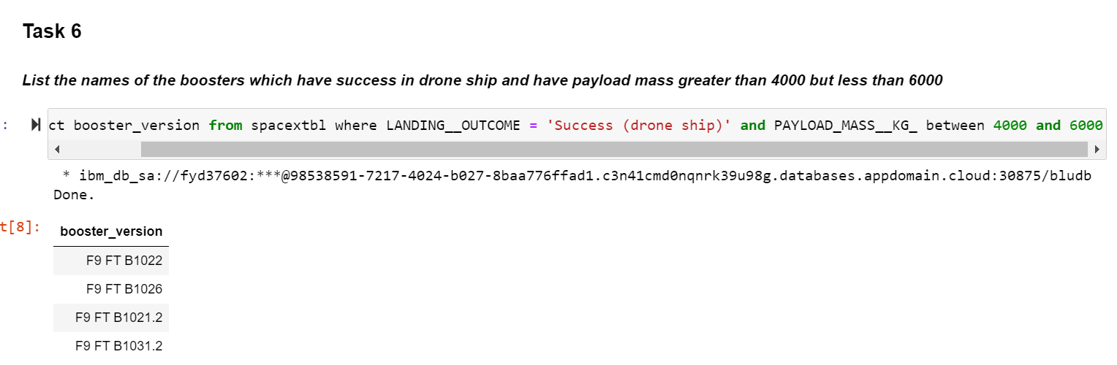
Successful Drone Ship Landing with Payload between 4000 and 6000
The WHERE clause was used to filter for boosters which have successfully landed on drone ship and applied the AND condition to determine successful landing with payload mass greater than 4000 but less than 6000 as shown below

Slide 30
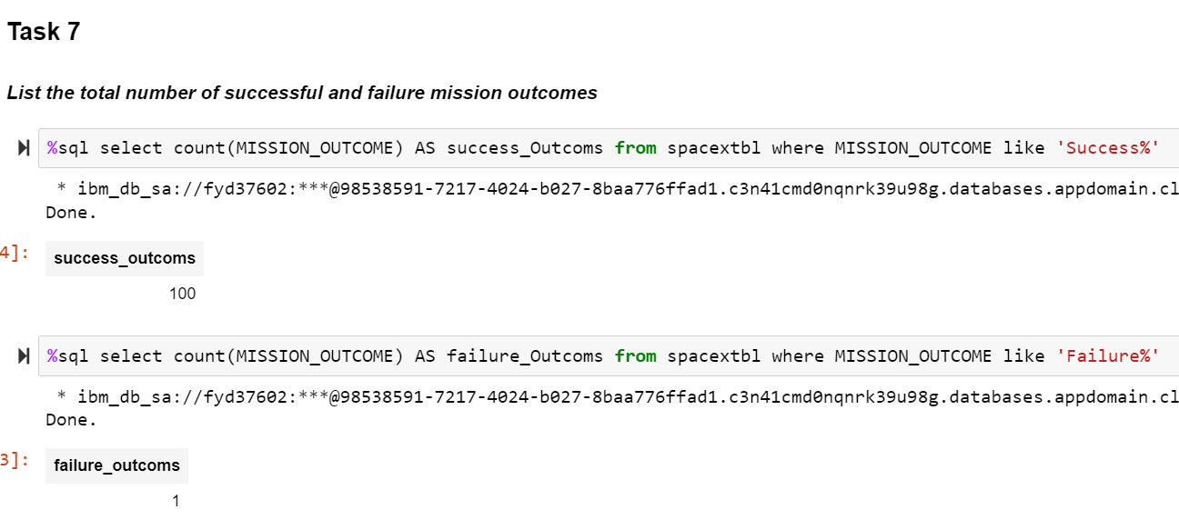
Total Number of Successful and Failure Mission Outcomes
The wildcard LIKE ‘%’ was used to filter for WHERE MISSION_OUTCOME was a success or a failure, as shown below

Slide 31
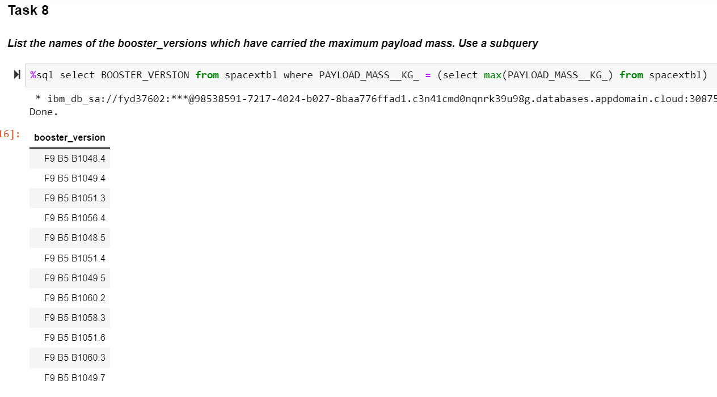
Boosters Carried Maximum Payload
it was determined the booster that have carried the maximum payload using a subquery in the WHERE clause and the MAX() function, as shown below

Slide 32
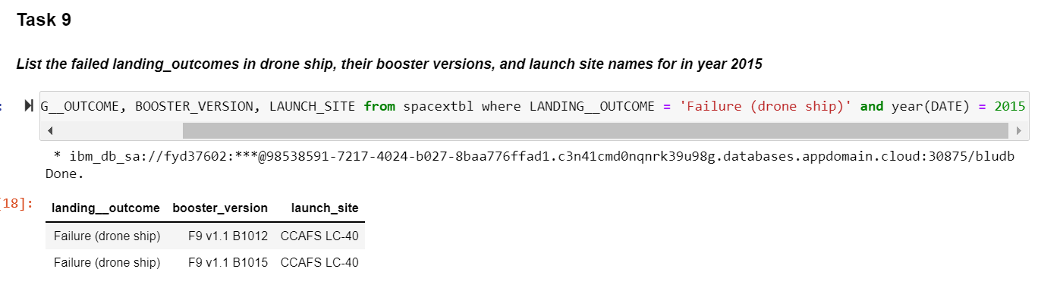
2015 Launch Records
A combinations of the WHERE clause, LIKE, AND, and BETWEEN conditions were used to filter for failed landing outcomes in drone ship, their booster versions, and launch site names for year 2015, as shown below

Slide 33
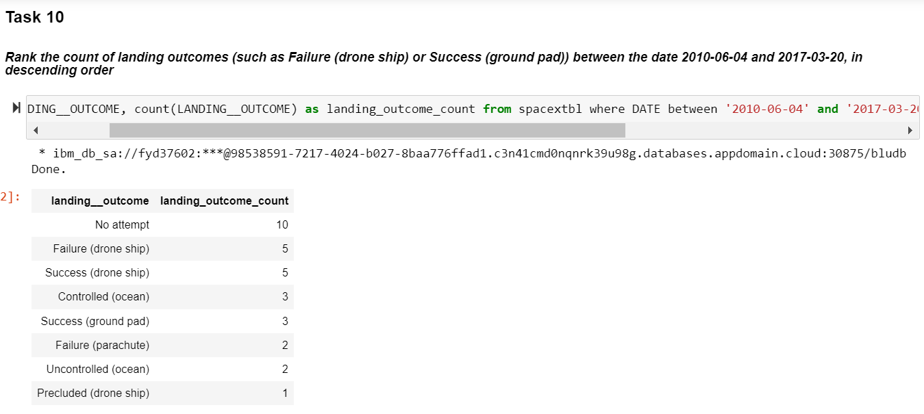
Rank Landing Outcomes Between 2010-06-04 and 2017-03-20
Landing outcomes and the COUNT of landing outcomes were selected from the data and used the WHERE clause to filter for landing outcomes BETWEEN 2010-06-04 to 2010-03-20. Then GROUP B clause was applied to group the landing outcomes and the ORDER BY clause was applied to order the grouped landing outcome in descending order.

Slide 34

Section 3

Slide 35
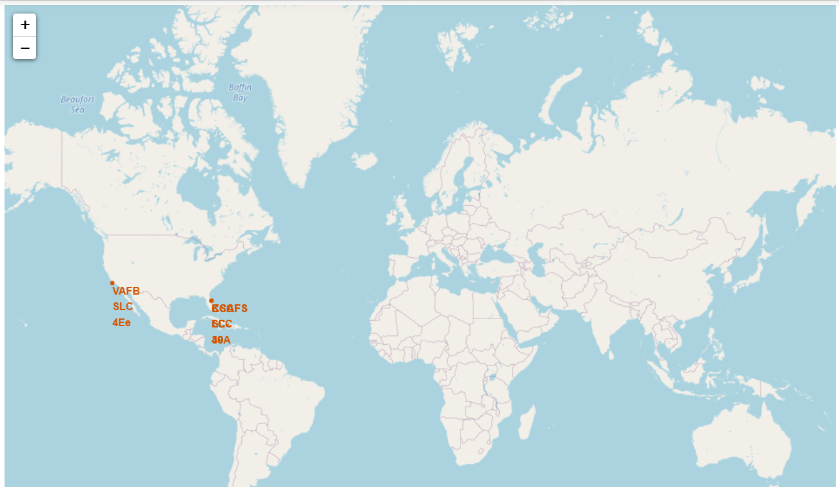
Global launch sites
It is shown that SpaceX launch sites are located in USA only, in Florida and California

Slide 36
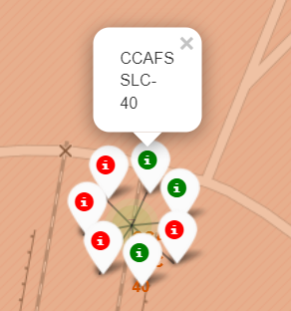
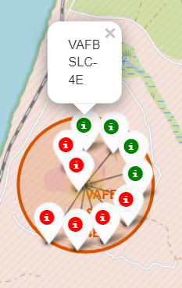
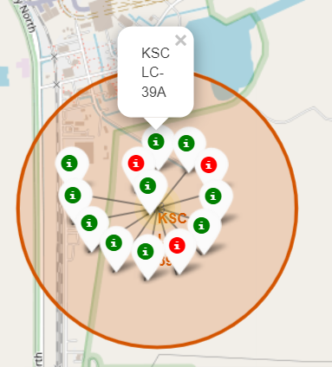
Launch sites with colors labels for success/failure
California
Green == Success
Red === Failure
Florida

Slide 37
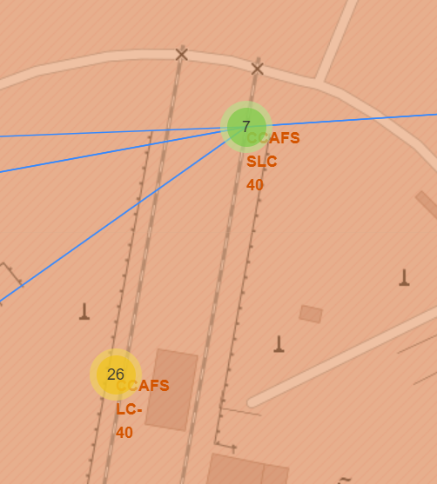
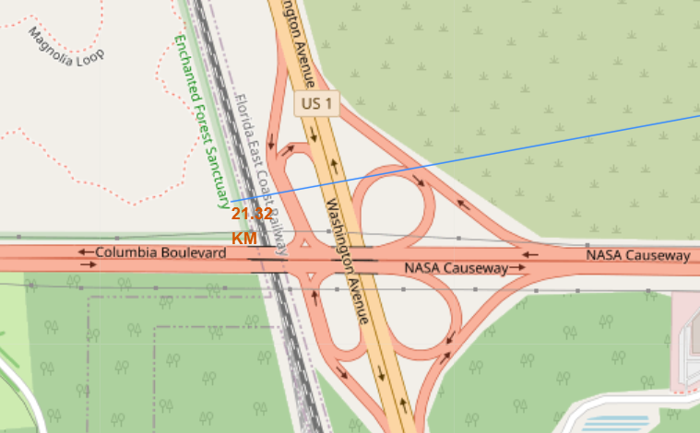
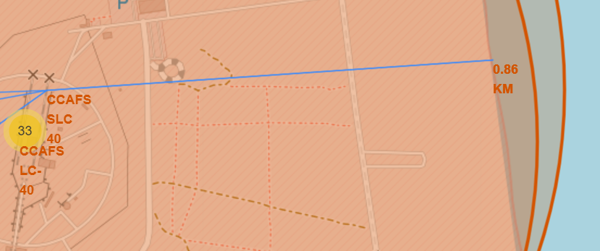
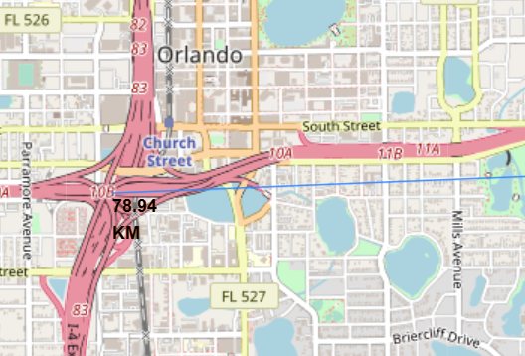
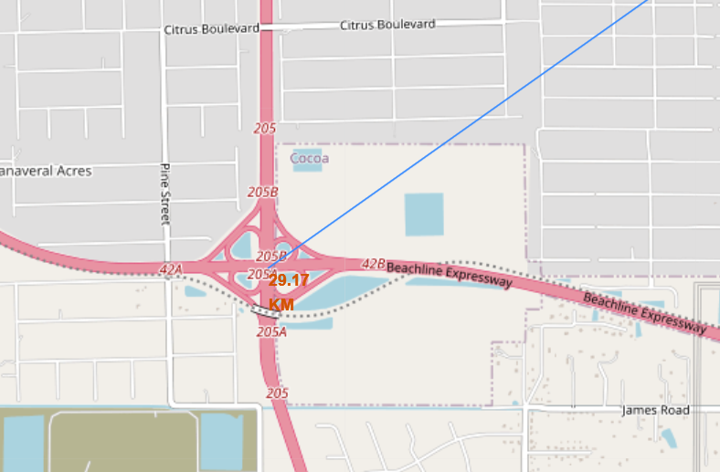
Important distances from launch site
Are launch sites in close proximity to railways? No
Are launch sites in close proximity to highways? No
Are launch sites in close proximity to coastline? Yes
Do launch sites keep certain distance away from cities? Yes
Distance to coastline
Distance to railway
Launch site
Distance to city
Distance to highway

Slide 38

Section 4

Slide 39
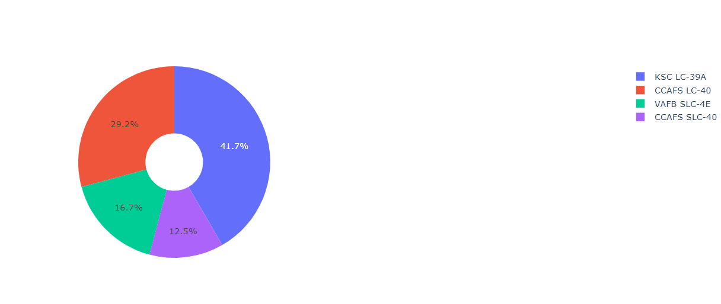
Success rate of each launch site in a pie chart
As shown, KSC LC-39A has the highest success rate of all launch sites

Slide 40
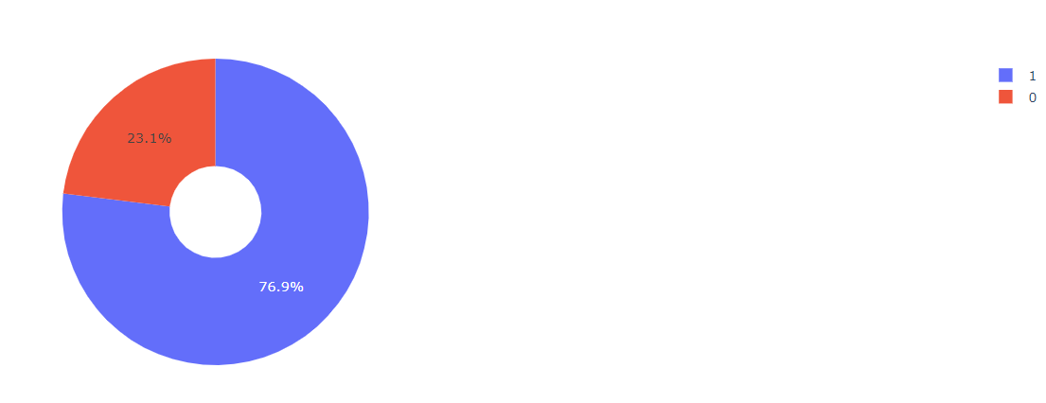
A pie chart showing the launch site with the highest success rate
KSC LC-39A has a success rate of 76.9% while its failure rate is only 23.1%

Slide 41
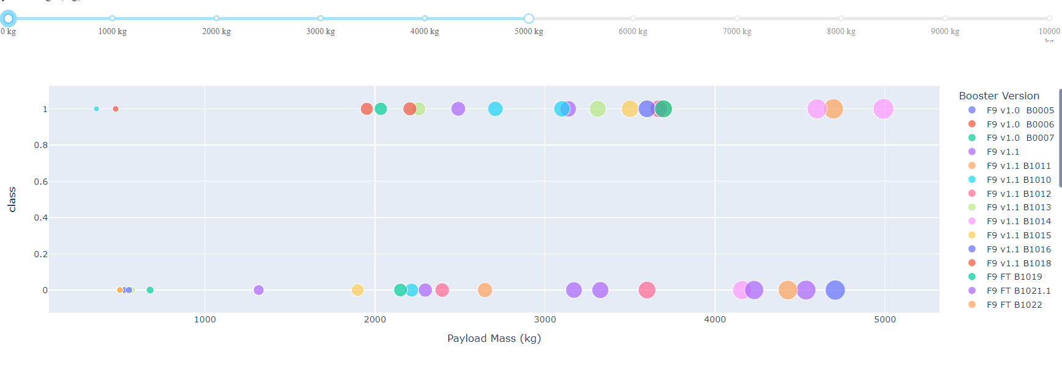
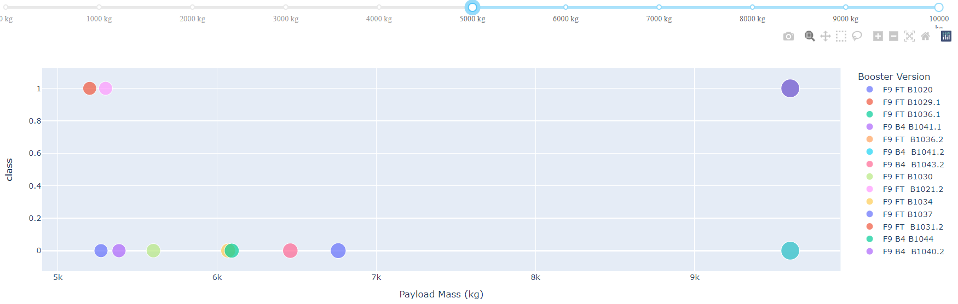
Scatter plot for success rate by payload mass
It was observed that payloads less than 5000 kg has higher success rate than those above it

Slide 42

Section 5

Slide 43
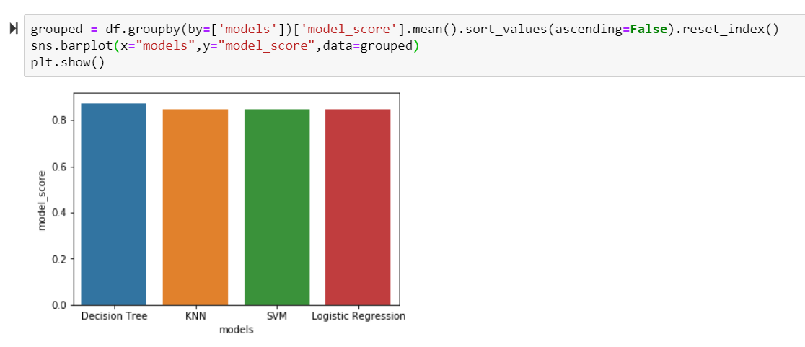
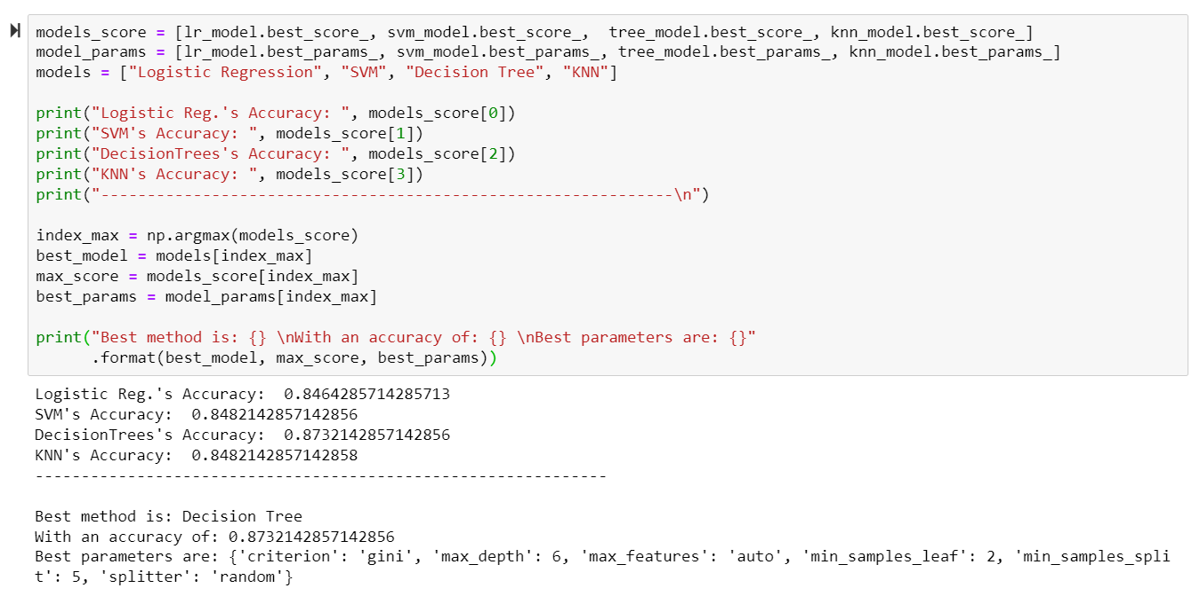
Classification Accuracy
The decision tree classifier was found to be the model with the highest classification accuracy

Slide 44
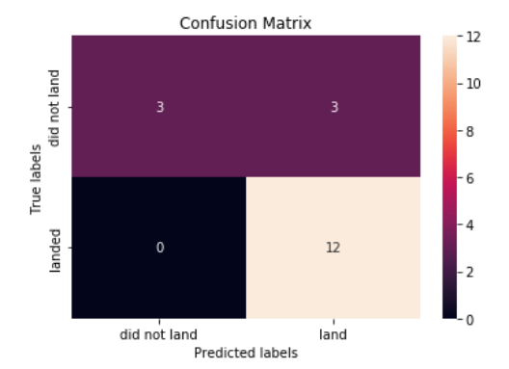
Confusion Matrix
As shown in the confusion matrix, the model has a false positive problem. But in general it performed good.

Slide 45
Conclusions
It was concluded that:
The more flight number a launch site has, it relates proportionally with its success rate.
The rate of success has been on the rise from 2013 till 2020.
Orbits ES-L1, GEO, HEO, SSO, VLEO had the highest success rate.
KSC LC-39A had the most successful launches of any sites.
The best machine learning algorithm was found to be the Decision tree classifier.

Slide 46


